Slide 1
FINAL PROJECTS
COMPUTER INFORMATION TECNOLOGY
RESUME CV
SPREAD SHEETS

Slide 2
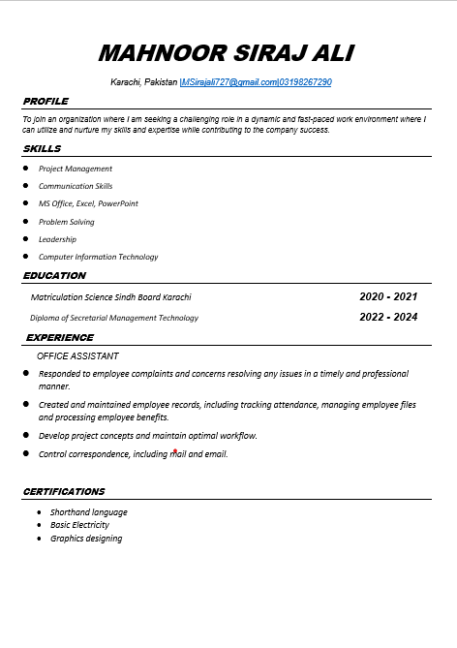
RESUME CV
It's important to note that a CV differs from a résumé. A CV is a comprehensive document that can be quite long, while a résumé is a shorter, more targeted summary focused on qualifications for a specific job.

Slide 3
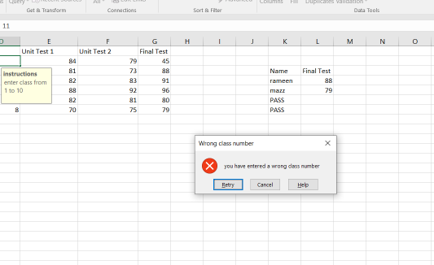
DECLARATIVE DATA VALIDATION
Data validation means checking the accuracy and quality of source data before using, importing or otherwise processing data. Different types of validation can be performed depending on destination constraints or objectives.

Slide 4
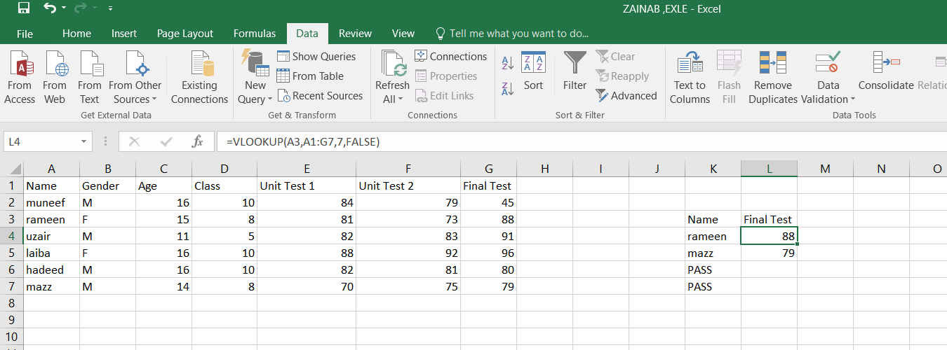
GUIDE TO USING VLOOKUP IN EXCEL
In Excel, the VLOOKUP function searches a table or range for a specified value in the first column and returns a corresponding value from another column in the same row.

Slide 5
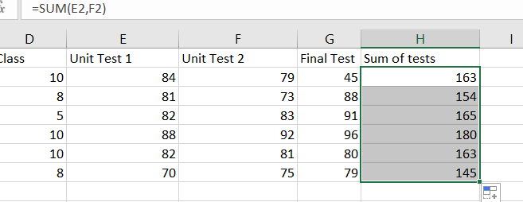
EXCEL SUM FORMULA
The SUM function adds values. You can add individual values, cell references or ranges or a mix of all three. For example: =SUM(A2:A10) Adds the values in cells A2:10.

Slide 6
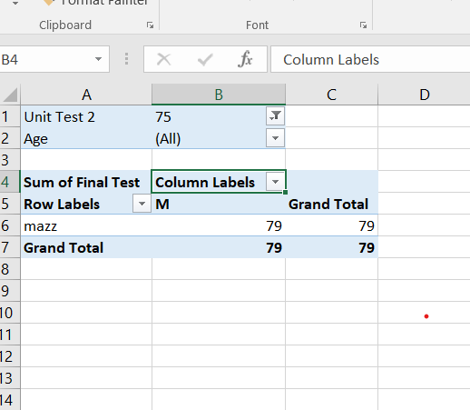
PIVOT TABLE TO ANALYZ IN EXCEL
an interactive way to quickly summarize large amounts of data. You can use a PivotTable to analyze numerical data in detail, and answer unanticipated questions about your data. A PivotTable is especially designed for: Querying large amounts of data in many user-friendly ways.

Slide 7
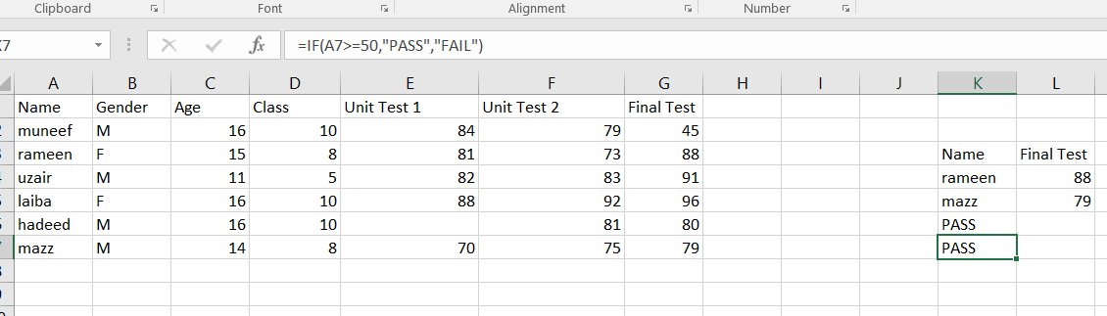
UPDATING IF FUNTONS IN EXCEL
The IF function is one of the most popular functions in Excel, and it allows you to make logical comparisons between a value and what you expect. So an IF statement can have two results. The first result is if your comparison is True, the second if your comparison is False.

Slide 8
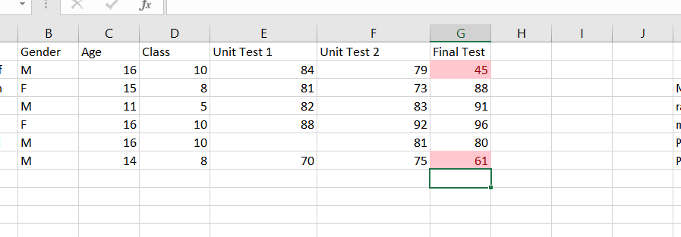
WORKING CONDITIONAL FORMATTING IN EXCEL
Conditional formatting makes it easy to highlight certain values or make particular cells easy to identify. This changes the appearance of a cell range based on a condition (or criteria). You can use conditional formatting to highlight cells that contain values which meet a certain condition.

